Slide 1

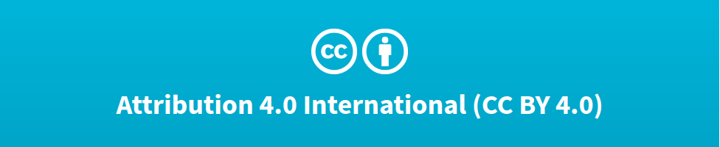

Idiomatic Programmer Learning Keras
Computer Vision Workshop Version: July 2019

Slide 2
Idiomatic Programmer Learning Keras
Repo: github.com/GoogleCloudPlatform/keras-idiomatic-programmer
Workshops, Handbooks, and Model Zoo

Slide 3
Computer Vision Workshop - 2019
Session 1 : Models
Session 2 : Data Engineering
Session 3 : Training & Deployment

Slide 4
Computer Vision - Models
Part 1 : Covered in Neural_Network Study Pack
Part 2 : Covered in Convolutional_Neural Network Study Pack
Part 3 : Covered in Wide_Convolutional_Neural_Networks
Part 4: Covered in Advanced_Convolutional_Neural_Networks
Part 5: Covered in Mobile_Networks

Slide 5
Computer Vision - Data Engineering
Part 6 : Covered in Data_Engineering
Part 7 : Covered in Data_Engineering
Part 8 : Covered in Data_Augmentation
Part 9 : Covered in Data_Curation

Slide 6
Image Augmentation
Image Augmentation
Image augmentation is the process of generating new images from existing images to improve the balance and/or variance in the training data. It is typically used to address:
Label(s) which have too few images.
Insufficient variance in [view] perspective.
Insufficient variance in lighting.
Image augmentation uses imaging algorithms which will modify an existing image without changing what the image is. That is, when a person views the modified image they will still see the same thing.

Slide 7
Image Augmentation - Cautionary Note
Image Augmentation - Underfitting
You should take image augmentation with some caution. As you increase the amount of image augmentation, the model will become more and more generalized. At some point the model may over generalized and become underfitted. In this situation, you will have a high rate of correctly classifying an image of label A is label A (True Positive - TP), but you will see a dramatic increase of the model classifying images of non-label A as label A (False Positive - FP). This is referred to as precision ( TP / (TP + FP)). So when using a high level of image augmentation, you need to pay attention to drops in precision as well as paying attention to accuracy.
Accuracy = TP Precision = TP
------------ ----------
No. of Samples TP + FP

Slide 8
Image Augmentation - Perspective
Image Augmentation - Perspective Change
In general practice, the augmentation method that contributes the most to increasing the accuracy of a neural network are changes in the perspective. The methods, also referred to as transformations, are:
Flip
Rotation
Zoom
Shift

Slide 9
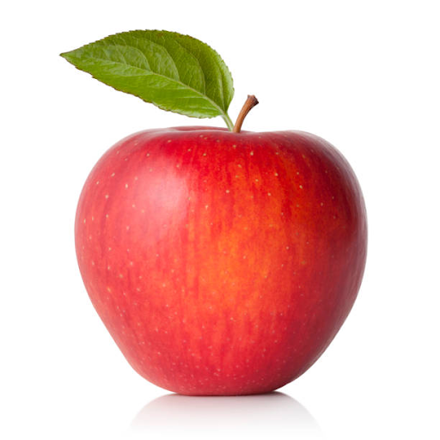
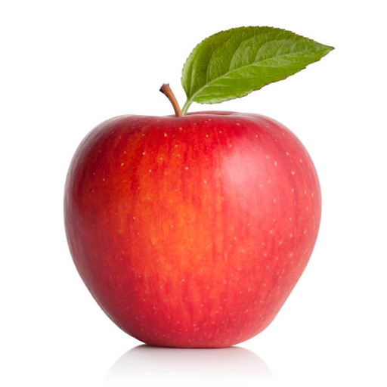
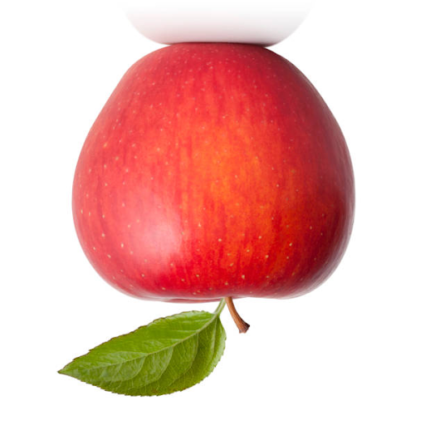
Image Augmentation - Flip
Image Augmentation - Flip
Flip transforms an image by flipping an image either on the vertical or horizontal axis. Since the image data is represented as a stack of 2D matrices (i.e., one per channel), A flip can be done efficiently as a matrix transpose function without changes (e.g., interpolation) of the pixel data.
Original Vertical Flip Horizontal Flip

Slide 10
Image Augmentation - Flip using PIL
Image Augmentation - Flip with PIL ImageOps Library
The code example below demonstrates how to flip an image vertically (mirror) and horizontally using a matrix transpose method in Python’s PIL imaging library:
from PIL import Image # read in the image image = Image.open('apple.jpg') # display the image in its original perspective image.show() # flip the image on the vertical axis (mirror) flip = image.transpose(Image.FLIP_LEFT_RIGHT) flip.show() # flip the image on the horizontal axis (upside down) flip = image.transpose(Image.FLIP_TOP_BOTTOM) flip.show()

Slide 11
Image Augmentation - ImageOps
Image Augmentation - Flip with PIL ImageOps
Alternately, the flips can be done using the PIL class ImageOps module, as demonstrated in the code below:
from PIL import Image, ImageOps # read in the image image = Image.open('apple.jpg') # flip the image on the vertical axis (mirror) flip = ImageOps.mirror(image) flip.show() # flip the image on the horizontal axis (upside down) flip = ImageOps.flip(image) flip.show()

Slide 12
Image Augmentation - Flip using OpenCV
Image Augmentation - Flip with OpenCV
The code example below demonstrates how to flip an image vertically (mirror) and horizontally using a matrix transpose method in OpenCV:
import cv2 from matplotlib import pyplot as plt # read in the image image = cv2.imread('apple.jpg') # display the image in its original perspective plt.imshow(image) # flip the image on the vertical axis (mirror) flip = cv2.flip(image, 1) plt.imshow(flip) # flip the image on the horizontal axis (upside down) flip = cv2.flip(image, 0) plt.imshow(flip)

Slide 13
Image Augmentation - Flip using Numpy
Image Augmentation - Flip with Numpy
The code example below demonstrates how to flip an image vertically (mirror) and horizontally using a matrix transpose method in numpy:
import numpy as np import cv2 from matplotlib import pyplot as plt # read in the image image = cv2.imread('apple.jpg') # flip the image on the vertical axis (mirror) flip = np.flip(image, 1) plt.imshow(flip) # flip the image on the horizontal axis (upside down) flip = np.flip(image, 0) plt.imshow(flip)

Slide 14
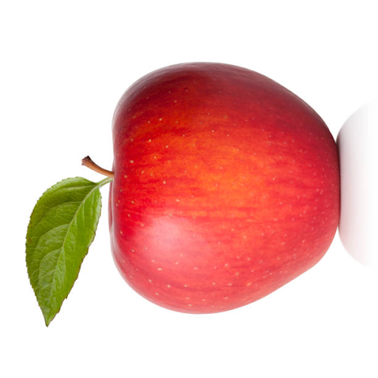
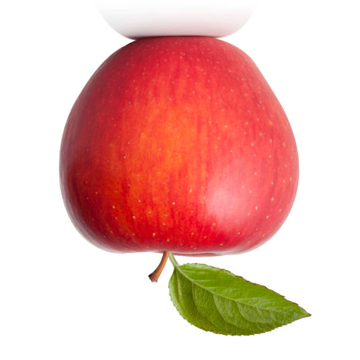
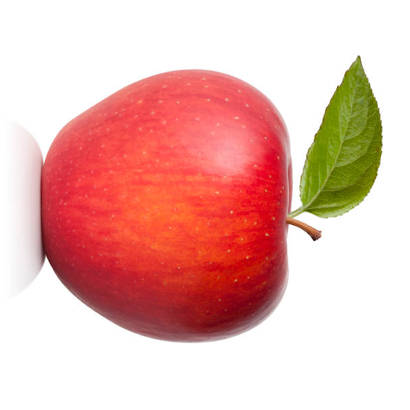
Image Augmentation - Rotation 90
Image Augmentation - Rotate 90 (right), 180 (upside down), 270 (left) degrees
In addition to flips, a matrix transpose operation can be used to rotate an image 90 degrees (left), 180 degrees, and 270 degrees (right). Like a flip, the operation is very efficient, and does not require interpolation of pixels and does not have a side effect of clipping.
90 180 270

Slide 15
Image Augmentation - Rotation 90 / PIL
Image Augmentation - Rotation 90 with PIL
The code example below demonstrates how to rotate an image 90, 180 and 270 degrees using a matrix transpose method in Python’s PIL imaging library:
from PIL import Image # read in the image image = Image.open('apple.jpg') # rotate the image 90 degrees rotate = image.transpose(Image.ROTATE_90) rotate.show() # rotate the image 180 degrees rotate = image.transpose(Image.ROTATE_180) rotate.show() # rotate the image 270 degrees rotate = image.transpose(Image.ROTATE_270) rotate.show()

Slide 16
Image Augmentation - Rotation 90 / Numpy
Image Augmentation - Rotation 90 with Numpy
The code example below demonstrates how to rotate an image 90, 180 and 270 degrees using the numpy method rot90(), where the first parameter is the image to rotate 90 degrees and the second parameter (k) is the number of times to perform the rotation:
# read in the image image = cv2.imread('apple.jpg') # rotate the image 90 degrees rotate = np.rot90(image, 1) plt.imshow(rotate) # rotate the image 180 degrees rotate = np.rot90(image, 2) plt.imshow(rotate) # rotate the image 270 degrees rotate = np.rot90(image, 3) plt.imshow(rotate)

Slide 17
Image Augmentation - Rotation
Image Augmentation - Rotation
A rotation transforms an image by rotating the image within -180 and 180 degrees. Generally, the degree of rotation is randomly selected. You may also want to limit the range of rotation to match the environment the model will be deployed in. Below are some common practices:
If the images will be dead-on, use -15 to 15 degree range.
If the images may be on an incline, use -30 to 30 degree range.
For small objects, like packages, money, use the full range of -180 to 180.
Another issue with rotation, is that if you rotate an image within the same size boundaries, other than 90, 180, or 270, a portion of the edge of the image will end up outside the boundary (i.e., clipped).

Slide 18
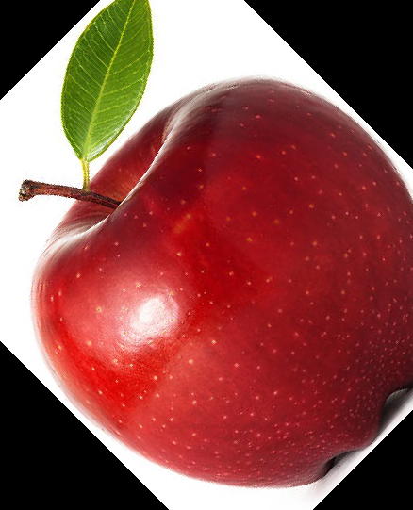
Image Augmentation - Rotation
Image Augmentation - Rotation
Below is an example of using PIL method rotate() to rotate the image of the apple 45 degrees. You can see part of the bottom of the apple and the stem are clipped.

Slide 19
Image Augmentation - Rotation
Image Augmentation - Rotation w/o Clipping (OpenCV)
The correct way to handle a rotation is to rotate it within a larger bounding area, such that none of the image is clipped, and then resize the rotated image back to the original size. For this purpose, I recommend using the imutils module (Adrian Rosebrock), which consists of a collection of convenience methods for openCV
import cv2, imutils from matplotlib import pyplot as plt # read in the image image = cv2.imread('apple.jpg') # remember the original Height and Width shape = (image.shape[0], image.shape[1]) # rotate the image rotate = imutils.rotate_bound(image, 45) # resize the image back to its original shape rotate = cv2.resize(rotate, shape, interpolation=cv2.INTER_AREA) plt.imshow(rotate)

Slide 20
Image Augmentation - Zoom / PIL
Image Augmentation - Zoom with PIL
Zoom transforms an image by zooming in from the center of the image, with is done with an resize and crop operation. First you find the center of the image, calculate the crop bounding box around the center, and then you crop the image.
When enlarging an image using Image.resize() the Image.BICUBIC interpolation generally provides the best results.
from PIL import Image image = Image.open('apple.jpg') zoom = 2 # zoom by factor of 2 # remember the original height, width of the image height, width = image.size # resize (scale) the image proportional to the zoom image = image.resize( (int(height*zoom), int(width*zoom)), Image.BICUBIC) # find the center of the scaled image center = (image.size[0]//2, image.size[1]//2) # calculate the crop upper left corner crop = (int(center[0]//zoom), int(center[1]//zoom)) # calculate the crop bounding box box = ( crop[0], crop[1], (center[0] + crop[0]), (center[1] + crop[1]) ) image = image.crop( box ) image.show()

Slide 21
Image Augmentation - Zoom / OpenCV
Image Augmentation - Zoom with OpenCV
When enlarging an image using cv2.resize() interpolation cv2.INTER_CUBIC generally provides the best results. The interpolation cv2.INTER_LINEAR is faster and provides nearly comparable results. The interpolation cv2.INTER_AREA is generally used when reducing an image.
import cv2 from matplotlib import pyplot as plt zoom = 2 # zoom by a factor of 2 # remember the original height, width of the image height, width = image.shape[:2] # find the center of the scaled image center = (image.shape[0]//2, image.shape[1]//2) z_height = int(height // zoom) z_width = int(width // zoom) # slice (cutout) the zoomed image by forming a crop bounding box image = image[(center[0] - z_height//2):(center[0] + z_height//2), center[1] - z_width//2:(center[1] + z_width//2)] # resize (enlarge) the cropped image back to the original size. image = cv2.resize(image, (width, height), interpolation=cv2.INTER_CUBIC) plt.imshow(image)

Slide 22
Image Augmentation - Shift / Numpy
Image Augmentation - Shift with Numpy
A shift will shift the pixel data in the image +/- in the vertical (height) or horizontal (width) axis. This will change the location in the image of the object being classified. The code below demonstrates shifting an image +/- 10% vertically and horizontally using the numpy np.roll() method.
import cv2 import numpy as np # read in the image image = cv2.imread('apple.jpg') # get the height and width of the image height = image.shape[0] Width = image.shape[1] # shift the image down by 10% roll = np.roll(image, height // 10, axis=0) # shift the image up by 10% roll = np.roll(image, -(height // 10), axis=0) # shift the image right by 10% roll = np.roll(image, width // 10, axis=1) # shift the image left by 10% roll = np.roll(image, -(width // 10), axis=1)

Slide 23
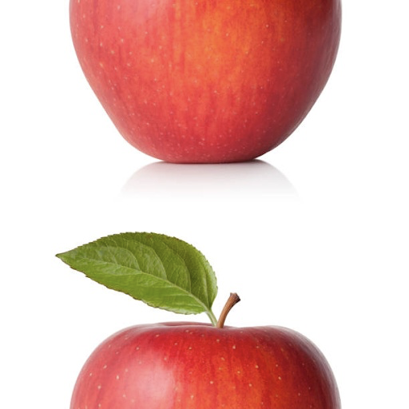
Image Augmentation - Fractured Shift
Image Augmentation - Fractured Shift
A shift is very efficient in that it is implemented as a roll operation of the matrix, where the rows (height) or columns (width) are shifted. As such, the pixels that are shifted off the end are added to the beginning. If the shift is too large, the image can become fractured into two pieces with each piece opposing each other.
Below is an example of where the apple was shifted by 50% vertically, leaving it fractured.
To avoid fracture, It is a general practice to limit the shift of the image to no more than 20%.

Slide 24
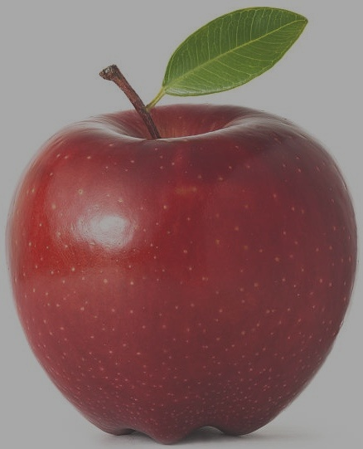
Image Augmentation - Lighting / OpenCV
Image Augmentation - Lighting / OpenCV
There are a number of techniques for changing lighting. For example:
Apply a uniform multiplier on each pixel.
Apply specific multiplier per channel on each pixel.
Apply specific multiplier per range of pixel values on each pixel.
The code below demonstrates using the OpenCV method convertScaleAbs(). This method applies a uniform multiplier across the pixels and a delta added to each value, specified by the parameters alpha and beta, respectively:
import cv2 image = cv2.imread('apple.jpg') contrast = 0.5 brightness = 40 # scale the pixel values and then convert back to uint8 image = cv2.convertScaleAbs(image, alpha=contrast, beta=brightness)

Slide 25
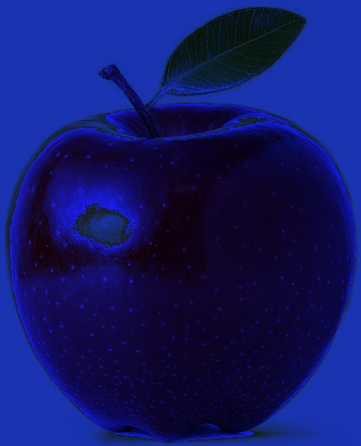
Image Augmentation - Lighting / OpenCV
Image Augmentation - Lighting / OpenCV
Below is an example of applying a multiplier per channel:
import cv2 import numpy as np from matplotlib import pyplot as plt image = cv2.imread('apple.jpg') # multiplier: Blue* 1.7, Green * 0.2, Red * 0.1 image = image * np.array([1.7, 0.2, 0.1]) image = image.astype(np.uint8) plt.imshow(image)

Slide 26
Image Augmentation in Keras
Image Augmentation in Keras
The Keras image preprocessing module supports a wide variety of image augmentation with the class ImageDataGenerator. The ImageDataGenerator class creates a generator for generating batches of augmented images. The class initializer takes as input zero or more parameters for specifying the type of augmentation. Below are a few of the parameters:
horizontal_flip=True
vertical_flip=True
rotation_range=degrees
zoom_range=(lower, upper)
width_shift_range=percent
height_shift_range=percent
brightness_range=(lower, upper)

Slide 27
Image Augmentation - Flip / Keras
Image Augmentation / Flip in Keras
In the next code example, we do the following:
Read in a single image of an apple.
Create batch of one image (the apple).
Instantiate an ImageDataGenerator object.
Initialize the ImageDataGenerator with our augmentation options (in this case: horizontal and vertical flip).
Use the flow() method of the ImageDataGenerator method to create a batch generator.
Iterate through the generator 6 times, each time returning a batch of 1 image in x.
The generator will randomly select an augmentation (including no augmentation) per iteration.
After transformation (augmentation), the pixel values will be 32-bit float.
Change the data type of the pixels back to 8-bit integer, for displaying using matplotlib.

Slide 28
Image Augmentation - Flip / Keras
Image Augmentation - Flip with Keras
from keras.preprocessing.image import ImageDataGenerator import cv2 import numpy as np from matplotlib import pyplot as plt # Let's make a batch of 1 image (apple) image = cv2.imread('apple.jpg') batch = np.asarray([image]) # Create a data generator for augmenting the data datagen = ImageDataGenerator(horizontal_flip=True, vertical_flip=True) # Let's run the generator, where every image is a random augmentation step=0 for x in datagen.flow(batch, batch_size=1): step += 1 if step > 6: break plt.figure() # the augmentation operation will change the pixel data to float # change it back to uint8 for displaying the image plt.imshow(x[0].astype(np.uint8))

Slide 29
Image Augmentation - Rotation / Keras
Image Augmentation - Rotation with Keras
In the code below, we use the rotation_range parameter to set random rotations between -60 and 60 degrees. Note, that rotate operation does not perform a bounds check and resize (like imutils.rotate_bound(), so part of the image may end up being clipped.
# Let's make a batch of 1 image (apple) image = cv2.imread('apple.jpg') batch = np.asarray([image]) # Create a data generator for augmenting the data datagen = ImageDataGenerator(rotation_range=60) # Let's run the generator, where every image is a random augmentation step=0 for x in datagen.flow(batch, batch_size=1): step += 1 if step > 6: break plt.figure() # the augmentation operation will change the pixel data to float # change it back to uint8 for displaying the image plt.imshow(x[0].astype(np.uint8))

Slide 30
Image Augmentation - Zoom / Keras
Image Augmentation - Zoom with Keras
In the code below, we use the zoom_range parameter to set random values between 0.5 (zoom out) and 2 (zoom in). Note that the value can be specified either as a tuple or list of two elements.
# Let's make a batch of 1 image (apple) image = cv2.imread('apple.jpg') batch = np.asarray([image]) # Create a data generator for augmenting the data datagen = ImageDataGenerator(zoom_range=(0.5, 2)) # Let's run the generator, where every image is a random augmentation step=0 for x in datagen.flow(batch, batch_size=1): step += 1 if step > 6: break plt.figure() # the augmentation operation will change the pixel data to float # change it back to uint8 for displaying the image plt.imshow(x[0].astype(np.uint8))

Slide 31
Image Augmentation - Shift / Keras
Image Augmentation - Shift with Keras
In the code below, we use the width_shift_range and height_shift_range to set random values between 0 and 20% in shift horizontally or vertically:
# Let's make a batch of 1 image (apple) image = cv2.imread('apple.jpg') batch = np.asarray([image]) # Create a data generator for augmenting the data datagen = ImageDataGenerator(width_shift_range=0.2, height_shift_range=0.2) # Let's run the generator, where every image is a random augmentation step=0 for x in datagen.flow(batch, batch_size=1): step += 1 if step > 6: break plt.figure() # the augmentation operation will change the pixel data to float # change it back to uint8 for displaying the image plt.imshow(x[0].astype(np.uint8))

Slide 32
Image Augmentation - Brightness / Keras
Image Augmentation - Brightness with Keras
In the code below, we use the brightness_range parameter to set random values between 0.5 darker) and 2 (brighter). Note that the value can be specified either as a tuple or list of two elements.
As a final note, transformations like brightness that add a fixed amount to the pixel value are done after normalization. If done before, then normalization would squash the values into the same original range, undoing the transformation.
# Let's make a batch of 1 image (apple) image = cv2.imread('apple.jpg') batch = np.asarray([image]) # Create a data generator for augmenting the data datagen = ImageDataGenerator(brightness_range=(0.5, 2))

Slide 33
Data Augmentation - Code Lab #2
Optional Code Lab - Get Familiar with Image Augmentation
Idiomatic Programmer - handbook 2 - Codelab 2.ipynb

Slide 34
Image Data Curation
You Only Get What You Trained For
As a data scientist and educator, I get a lot of questions from software engineers on how to improve the accuracy of a model. The five basic answers to increase the performance of the model are:
Increase training time.
Increase the depth of the model.
Add regularization.
Expand dataset with data augmentation.
Increase hyperparameter tuning.
While the above may or may not improve accuracy, the limitation ultimately is in the dataset used to train the model.

Slide 35
Image Data Curation
The term “Model” originates from Statistics
The term “model” was not created by AI, or by machine learning, or otherwise a new thing. The term “model” originates from statistics. As a software engineer, you’re used to coding an algorithm that generally has a one-to-one relationship between the input and output --we typically refer to this as the inputs have a linear relationship to the output; or in otherwise, the output is deterministic.
The field of statistics deals with algorithms that are not deterministic. These algorithms are called models --which model a behavior to make an output (outcome) prediction over a probability distribution. That sure sounds like statistics, right! In this part, we will cover distributions, particularly population, sub-population and sampling distributions --in how they affect the training of a model.

Slide 36
Image Data Curation
The term “Machine Learning”
In statistics, these models may start initially simple, like a linear or logistic regression, but quickly can become complex when modeling a complex behavior, such as forecasting the weather.
The advent of deep learning using neural networks to develop models is from the field of artificial intelligence. In recent years, these two separate (sub) fields have fused together and we collectively call both now machine learning. But whether you are doing what I refer to as classical machine learning (statistics) or deep learning, the limitation in what you can model (learn) is with the dataset.

Slide 37
Data Curation - Population Distribution
Population Distribution
This is important and likely the primary source when you make a model and it turns out to not perform as you expected “in the wild” (i.e., production). If you were to build a model to predict the shoe size of an adult male in the United States, then the population distribution of this model would be all adult males in the United States, and their different shoe sizes and corresponding features (e.g., height, ethnicity, etc) would be the distribution of shoe sizes in the population. That’s what we want to model and predict.

Slide 38
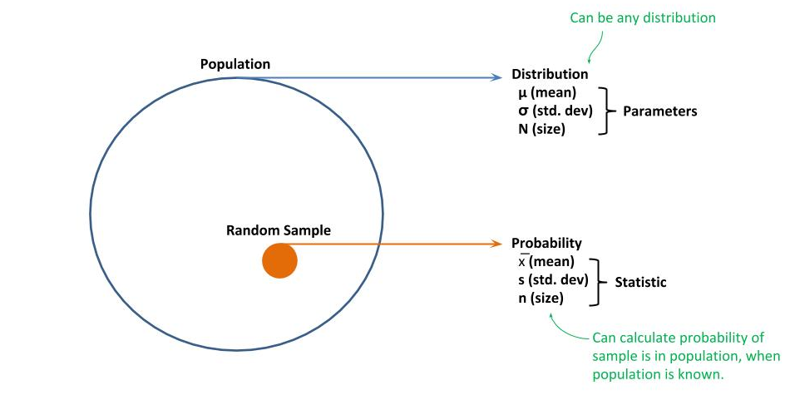
Data Curation - Population Distribution
Population Distribution - Random Sampling
The problem is that you would not have data for all adult males in the United States. Instead, you will have some subset of data; whereby, one takes batches of the data at random, which we call a random sample, to determine a distribution within the batch.

Slide 39
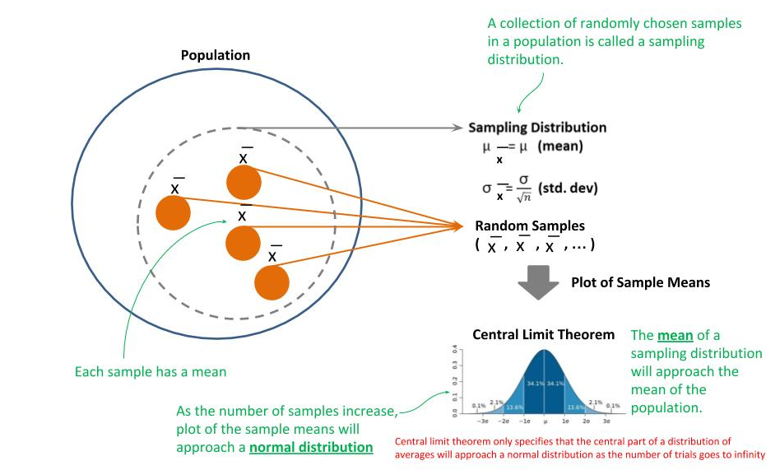
Data Curation - Sampling Distribution
Sampling Distribution
The goal is to have enough random samples of the population; that collectively the distributions within these samples can be used to predict the distribution within the population as a whole; which is referred to as a sampling distribution. The keyword here is “predict”, meaning we are determining a probabilistic distribution vs. a deterministic distribution.

Slide 40
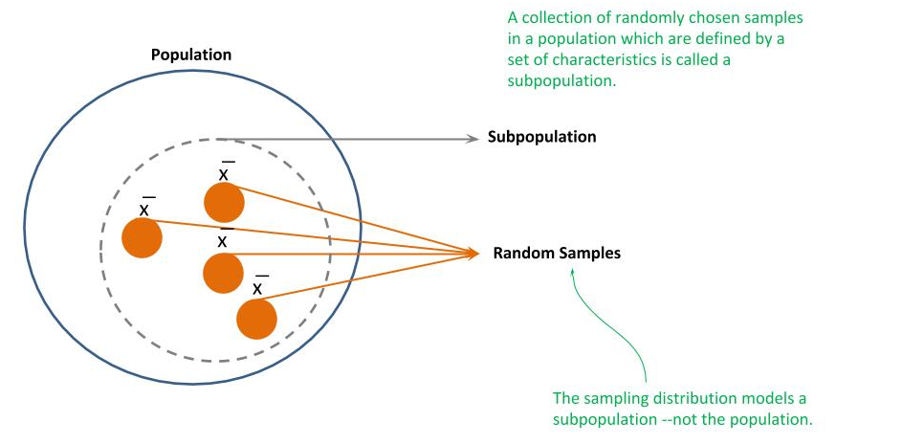
Data Curation - Subpopulation Distribution
Subpopulation Distribution
Regardless of how large and comprehensive your dataset is, it is likely a sampling distribution of a subpopulation and not the population. A subpopulation is a subset of a population that is defined by a set of characteristics, which would not have the same probability distribution of the population. As in our earlier adult male shoe example, let’s assume our samples are all from a chain of stores that specialize in selling sports shoes to professional athletes. While with sufficient samples, we can develop a sampling distribution which is representative (predictive) of the subpopulation, it is unlikely to be representative of the population.

Slide 41
Data Curation - Curated Datasets
Curated Datasets - MNIST as an example
MNIST is a dataset of 70,000 images of handwritten digits, proportionally balanced across each digit. It’s super easy to train a model to get near 100% accuracy on the dataset (and hence why it’s the hello world example of machine learning). But almost all “in the wild” application of the trained model will fail --because the distribution of images in MNIST is a subpopulation.
MNIST is a curated dataset. That is, the data curator selected samples for inclusion whose characteristics meet a definition. In the case of MNIST, each sample is:
a 28x28 pixel image,
with the digit centered in the middle,
the digit is white and the background is gray,
and there is at least a 4 pixel padding around the digit.

Slide 42
Curated Dataset - Environment Setup
Environment Setup
Below is a code snippet we will use throughout our examples. It includes importing the Keras framework for designing/training models, various Python libraries we will use, and finally the loading of the MNIST dataset that is prebuilt into the Keras framework.
# Keras classes we will use to build models from keras import Sequential, Input from keras.layers import Flatten, Dense, Activation, ReLU, Conv2D, MaxPooling2D, Dropout from keras.utils import to_categorical # Keras library for the builtin MNIST dataset from keras.datasets import mnist # Other python modules for preparation/manipulating the images import numpy as np import random import cv2 # Get the builtin dataset from Keras (x_train, y_train), (x_test, y_test) = mnist.load_data()

Slide 43
Curated Dataset - Dataset Preparation
Prepare Builtin Dataset
The dataset from Keras is in a generic format, so we need to do some initial data preparation to use it for training a dense neural network (DNN) and convolutional neural network (CNN). These include:
The pixel data (x_train and x_test) are in the original INT8 values (0 .. 255). We will normalize the pixel data to be between 0 and 1 as a FLOAT32.
The image data are matrices of shape Height x Width (H x W). Keras expects tensors in the shape of Height x Width x Channel. These are grayscale images, so we will reshape the train and test data to (H x W x 1).
The labels (y_train and y_test) are the original scalar value. We will one-hot encode them into vectors.
We are also going to set aside a copy of the test and training data before it’s been prepared.

Slide 44
Curated Dataset - Dataset Preparation
Prepare Builtin Dataset
# Let's set aside a copy of the original test data and training data x_test_copy = x_test x_train_copy = x_train # Let's normalize the training/test data and cast to float32 x_train = (x_train / 255.0).astype(np.float32) x_test = (x_test / 255.0).astype(np.float32) # Let's reshape for Keras from (H,W) to (H,W,C) x_train = x_train.reshape(-1, 28, 28, 1) x_test = x_test.reshape(-1, 28, 28, 1) # this will output (60000, 28, 28, 1) and (10000, 28, 28, 1) print("x_train", x_train.shape, "x_test", x_test.shape) # We need to convert the labels to one-hot-encoding y_train = to_categorical(y_train) y_test = to_categorical(y_test) # this will output (60000, 10) and (10000, 10) print("y_train", y_train.shape, "y_test", y_test.shape)

Slide 45
Curated Dataset - In the Wild
The Challenge (“In the Wild”)
In addition to randomly choosing test data (holdout set) from this curated dataset, we will create two additional test datasets as examples of what the trained model may see in the wild. We will use these two additional test datasets to demonstrate how the model will fail, ways we might modify the training and dataset to overcome this, and the limitations. The two additional test datasets are:
Inverted - The pixel data is inverted such that the images are now gray digits on white background.
Shifted - The images are shifted 4 pixels to the right, and thus are not centered anymore. Since there is at least a padding of 4 pixels, none of the digits will be clipped.

Slide 46
Curated Dataset - In the Wild
The Challenge (“In the Wild”)
Below are an example of a single test image from the original test data, the inverted test data and the shifted test data.
Original Inverted Shifted
# This is the inverted test dataset x_test_invert = np.invert(x_test_copy) x_test_invert = (x_test_invert / 255.0).astype(np.float32) # This is the shifted test dataset x_test_shift = np.roll(x_test_copy, 4) x_test_shift = (x_test_shift / 255.0).astype(np.float32) # Let's reshape for Keras from (H,W) to (H,W,C) x_test_invert = x_test_invert.reshape(-1, 28, 28, 1) x_test_shift = x_test_shift.reshape(-1, 28, 28, 1)

Slide 47
Curated Dataset - In the Wild
Training as a DNN
MNIST is so easy, we can build a classifier with 97%+ accuracy with a DNN (w/o the need for a CNN). Below is a code example of a function for constructing simple DNNs, consisting of:
The parameter nodes is a list specifying the number of nodes per layer.
The input to the DNN are images in the shape 28x28x1
The input is flattened into a 1D vector of length 784.
There is an optional dropout (for regularization) after each layer.
The last dense layer of 10 nodes with a softmax activation function is the classifier.
def DNN(nodes, dropout=False): model = Sequential() model.add(Flatten(input_shape=(28, 28, 1))) for n_nodes in nodes: model.add(Dense(n_nodes)) model.add(ReLU()) if dropout: model.add(Dropout(0.5)) dropout /= 2.0 model.add(Dense(10)) model.add(Activation('softmax')) # For a multi-class classification problem model.compile(optimizer='rmsprop', loss='categorical_crossentropy', metrics=['accuracy']) model.summary() return model

Slide 48
Curated Dataset - In the Wild
Training as a DNN
For our first test, we will train the dataset on a single layer (excluding the output layer) of 512 nodes.
model = DNN([512]) model.fit(x_train, y_train, epochs=10, batch_size=32, shuffle=True, verbose=2) score = model.evaluate(x_test, y_test, verbose=1) print("test", score) Output: test [0.11250439590732676, 0.9791]

Slide 49
Curated Dataset - In the Wild
Training as a DNN
So far looks good. Let’s now try the model on the inverted and shifted test datasets. Our accuracy on the inverted is only 2%, and on the shifted it does better but only 41%.
What happened? For the inverted, it looks like our model learned the gray background and the whiteness of the digit as part of the digit recognition. Thus, when we inverted it, it totally failed to classify it.
For the shifted, a dense layer does not preserve spatial relationships between the pixels. Each pixel is a unique feature. Thus, even the shift of a few pixels was enough to dramatically drop the accuracy.
score = model.evaluate(x_test_invert, y_test, verbose=1) print("inverted", score) score = model.evaluate(x_test_shift, y_test, verbose=1) print("shifted", score) Output: inverted [15.660332287597656, 0.0206] shifted [7.46930496673584, 0.4107]

Slide 50
Curated Dataset - In the Wild
DNN - Add More Nodes
So an approach one might guess to improve the accuracy is to increase the number of nodes in the input layer --more nodes, better learning. Let’s repeat the same test with 1024 nodes.
We see a marginal increase on the inverted to about 5%, but it’s so low that’s probably just noise, and the accuracy on the shifted is about the same at 40%.
model = DNN([1024]) model.fit(x_train, y_train, epochs=10, batch_size=32, shuffle=True, verbose=2) score = model.evaluate(x_test_invert, y_test, verbose=1) print("inverted", score) score = model.evaluate(x_test_shift, y_test, verbose=1) print("shifted", score) Output: inverted [15.157325344848633, 0.0489] shifted [7.736222146606445, 0.4038]

Slide 51
Curated Dataset - In the Wild
DNN - Add More Layers
So another approach one might guess is to increase the number of layers. This time let’s make the DNN with two 512 node layers.
We see another slight increase in the shifted to 10%. But did it really improve. We have 10 classes (digits). If we made random guesses we be right 10% of the time. This is still purely a random outcome --nothing learned here. Looks like adding layers did not aid in learning the spatial relationships either.
model = DNN([512, 512]) model.fit(x_train, y_train, epochs=10, batch_size=32, shuffle=True, verbose=2) score = model.evaluate(x_test_invert, y_test, verbose=1) print("inverted", score) score = model.evaluate(x_test_shift, y_test, verbose=1) print("shifted", score) Output: inverted [14.464950880432129, 0.1025] shifted [8.786513813018798, 0.3887]

Slide 52
Curated Dataset - In the Wild
DNN - Add Regularization
Another approach would be to add some regularization to prevent overfitting the model to the training data and be more generalized. We will use the same two layer DNN of 512 nodes per layer, and add a 50% dropout after the first layer and 25% dropout after the second layer. It’s a common practice to use a higher dropout at the first layer where the layer is learning coarse features and smaller dropout at subsequent layers which are learning finer features.
Nope, no improvement. Thus widening a layer, adding layers, and regularization did not help in training the model to recognize the digits in our alternate test datasets.
model = DNN([512, 512], True) model.fit(x_train, y_train, epochs=10, batch_size=32, shuffle=True, verbose=2) score = model.evaluate(x_test_invert, y_test, verbose=1) print("inverted", score) score = model.evaluate(x_test_shift, y_test, verbose=1) print("shifted", score) Output: inverted [15.862942279052735, 0.0144] shifted [8.341207506561279, 0.3965]

Slide 53
Curated Dataset - In the Wild
Training as a CNN
With convolutional layers, we should at least learn the spatial relationships. Perhaps the convolutional layers will also filter out the background as well as the whiteness of the digits. Below is the code for constructing our CNNs:
The parameter filters is a list specifying the number of filters per convolution.
The input to the CNN are images in the shape 28x28x1
A max pooling which reduces the feature map sizes by 75% after each convolution.
A dropout (regularization) of 25% after each convolution/max pooling layer.
The last dense layer of 10 nodes with a softmax activation function is the classifier.
def CNN(filters): model = Sequential() first = True for n_filters in filters: if first: model.add(Conv2D(n_filters, (3, 3), strides=1, input_shape=(28, 28, 1))) else: model.add(Conv2D(n_filters, (3, 3), strides=1)) model.add(ReLU()) model.add(MaxPooling2D((2, 2), strides=2)) model.add(Dropout(0.25)) model.add(Flatten()) model.add(Dense(10)) model.add(Activation('softmax')) # For a multi-class classification problem model.compile(optimizer='rmsprop', loss='categorical_crossentropy',metrics=['accuracy']) return model

Slide 54
Curated Dataset - In the Wild
Training as a CNN
Let’s start with a CNN with a single convolutional layer of 16 filters.
We can see we went from a previous high of 10% accuracy on the inverted data to 50% accuracy. Thus, it does seem the convolutional layers help filter out (not learn) the background or whiteness of the digits. But it’s still far too low in accuracy. For the shifted, we increased to 57%. Still below our target, but we can also see now have the convolutional layers are learning the spatial relationships.
model = CNN([16]) model.fit(x_train, y_train, epochs=10, batch_size=32, shuffle=True, verbose=2) score = model.evaluate(x_test, y_test, verbose=1) print("test", score) score = model.evaluate(x_test_invert, y_test, verbose=1) print("inverted", score) score = model.evaluate(x_test_shift, y_test, verbose=1) print("shifted", score) Output: test [0.05741905354047194, 0.9809] inverted [2.1893138484954835, 0.5302] shifted [2.231996842956543, 0.5682]

Slide 55
Curated Dataset - In the Wild
Training as a CNN
If one convolutional layer improved things, let’s see how much better we can do with two convolutional layers. We will use two layers, the first with 16 filters and the second with 32 filters. It’s a common practice to double the number of filters as you get successively deeper into a CNN.
Our inverted test data went up to 63%. So it’s more learning to filter out the background and whiteness of the digits, but still not there. Our shifted test jumped to 76%. So you can see how convolutional layers are learning the spatial relationships in the digits vs. position in the image (compared to a DNN).
model = CNN([16, 32]) model.fit(x_train, y_train, epochs=10, batch_size=32, shuffle=True, verbose=2) score = model.evaluate(x_test_invert, y_test, verbose=1) print("inverted", score) score = model.evaluate(x_test_shift, y_test, verbose=1) print("shifted", score) Output: inverted [1.2761547603607177, 0.6332] shifted [0.6951200264453888, 0.7679]

Slide 56
Curated Dataset - In the Wild
Image Augmentation
Let’s use image augmentation. Image augmentation is a process for generating new samples from existing samples by making some small modifications, such that the modification would not change what the image would be classified as, and the image would be still recognized by the human eye as being that class.
In addition to adding more samples to the training set, certain types of augmentation can also aid in generalizing the model to accurately classify images outside of the test (holdout) dataset that it would’ve otherwise failed on.
We are going to improve this by using image augmentation to randomly shift the image left or right upto 20%. Since our images are 28 pixels wide, 20% would mean that the image gets shifted a maximum of six pixels in either direction. We have a minimum of a four pixel boundary, so there will be little to no clipping of the digits.

Slide 57
Curated Dataset - In the Wild
Image Augmentation
We will use the ImageDataGenerator class in Keras to do the image augmentation. In the code example below, we do the following:
Create the same CNN model as before.
Instantiate an ImageDataGenerator generator object where the parameter width_shift_range=0.2 will augment the dataset during training by randomly shifting images +/- 20%.
We invoke the fit_generator() method to train the model using our image augmentation generator with our existing training data.
We specify the number of steps_per_epoch in the generator as the number of training samples divided by the batch size; otherwise, the generator would loop indefinitely on the first epoch.
from keras.preprocessing.image import ImageDataGenerator model = CNN([16, 32]) datagen = ImageDataGenerator(width_shift_range=0.2) model.fit_generator(datagen.flow(x_train, y_train, batch_size=32), steps_per_epoch= 60000 // 32 , epochs=10)

Slide 58
Curated Dataset - In the Wild
Image Augmentation
Let’s see if this improves the accuracy on our alternate test data.
Wow, our accuracy on the shifted data is now nearly 98%. So we were able to train the model to learn the spatial relationships of digits when their shifted in the image without increasing the complexity of the model.
score = model.evaluate(x_test, y_test, verbose=1) print("test", score) score = model.evaluate(x_test_invert, y_test, verbose=1) print("inverted", score) score = model.evaluate(x_test_shift, y_test, verbose=1) print("shifted", score) Output: test [0.046405045648082156, 0.986] inverted [4.463096208190918, 0.2338] shifted [0.06386796866590157, 0.9796]

Slide 59
Curated Dataset - In the Wild
Image Augmentation
Let’s now tackle training the model to filter out the background and whiteness of the digits. In the code below we take 10% of the training data (x_train_copy[0:6000]) and invert it like we did with the test data. Why 10% instead of the whole training data? When we want to train a model to filter out something, we generally can do it with as little as 10% of the distribution of the entire training data.
Next we combine the original training data with the additional inverted training data by appending the two training sets together (both x_train --the data, and y_train --the labels), for a total of 66,000 images (vs. 60,000) in our training set.
Wow, our accuracy on the shifted data is now nearly 98%. So we were able to train the model to learn the spatial relationships of digits when their shifted in the image without increasing the complexity of the model.
# Select 10% of the (copy of) training data and invert it. x_train_invert = np.invert(x_train_copy[0:6000]) x_train_invert = (x_train_invert / 255.0).astype(np.float32) x_train_invert = x_train_invert.reshape(-1, 28, 28, 1) # Select the same 10% of the corresponding labels y_train_invert = x_train[0:6000] # Next, combine the two training datasets into a single training set x_combine = np.append(x_train, x_train_invert, axis=0) y_combine = np.append(y_train, y_train_invert, axis=0)

Slide 60
Curated Dataset - In the Wild
Image Augmentation
Let’s now train using the combined dataset and image augmentation to randomly shift the image +/- 20%
Wow, our test accuracy on the inverted images is nearly 96%.
model = CNN([16, 32]) datagen = ImageDataGenerator(width_shift_range=0.2) model.fit_generator( datagen.flow(x_combine, y_combine, batch_size=32), steps_per_epoch= 66000 // 32, epochs=10) score = model.evaluate(x_test, y_test, verbose=1) print("test", score) score = model.evaluate(x_test_invert, y_test, verbose=1) print("inverted", score) score = model.evaluate(x_test_shift, y_test, verbose=1) print("shifted", score) Output: test [0.04763028650498018, 0.9847] inverted [0.13941174189522862, 0.9589] shifted [0.06449916120804847, 0.979]

Slide 61
Data Augmentation - Code Lab #2
Optional Code Lab - Get Familiar with Data Augmentation
Idiomatic Programmer - handbook 2 - Codelab 2.ipynb

Slide 62
Image Data Curation
You Only Get What You Trained For
As a data scientist and educator, I get a lot of questions from software engineers on how to improve the accuracy of a model. The five basic answers to increase the performance of the model are:
Increase training time.
Increase the depth of the model.
Add regularization.
Expand dataset with data augmentation.
Increase hyperparameter tuning.
While the above may or may not improve accuracy, the limitation ultimately is in the dataset used to train the model.

Slide 63
Image Data Curation
The term “Model” originates from Statistics
The term “model” was not created by AI, or by machine learning, or otherwise a new thing. The term “model” originates from statistics. As a software engineer, you’re used to coding an algorithm that generally has a one-to-one relationship between the input and output --we typically refer to this as the inputs have a linear relationship to the output; or in otherwise, the output is deterministic.
The field of statistics deals with algorithms that are not deterministic. These algorithms are called models --which model a behavior to make an output (outcome) prediction over a probability distribution. That sure sounds like statistics, right! In this part, we will cover distributions, particularly population, sub-population and sampling distributions --in how they affect the training of a model.

Slide 64
Image Data Curation
The term “Machine Learning”
In statistics, these models may start initially simple, like a linear or logistic regression, but quickly can become complex when modeling a complex behavior, such as forecasting the weather.
The advent of deep learning using neural networks to develop models is from the field of artificial intelligence. In recent years, these two separate (sub) fields have fused together and we collectively call both now machine learning. But whether you are doing what I refer to as classical machine learning (statistics) or deep learning, the limitation in what you can model (learn) is with the dataset.

Slide 65
Data Curation - Population Distribution
Population Distribution
This is important and likely the primary source when you make a model and it turns out to not perform as you expected “in the wild” (i.e., production). If you were to build a model to predict the shoe size of an adult male in the United States, then the population distribution of this model would be all adult males in the United States, and their different shoe sizes and corresponding features (e.g., height, ethnicity, etc) would be the distribution of shoe sizes in the population. That’s what we want to model and predict.

Slide 66
Data Curation - Population Distribution
Population Distribution - Random Sampling
The problem is that you would not have data for all adult males in the United States. Instead, you will have some subset of data; whereby, one takes batches of the data at random, which we call a random sample, to determine a distribution within the batch.

Slide 67
Data Curation - Sampling Distribution
Sampling Distribution
The goal is to have enough random samples of the population; that collectively the distributions within these samples can be used to predict the distribution within the population as a whole; which is referred to as a sampling distribution. The keyword here is “predict”, meaning we are determining a probabilistic distribution vs. a deterministic distribution.

Slide 68
Data Curation - Subpopulation Distribution
Subpopulation Distribution
Regardless of how large and comprehensive your dataset is, it is likely a sampling distribution of a subpopulation and not the population. A subpopulation is a subset of a population that is defined by a set of characteristics, which would not have the same probability distribution of the population. As in our earlier adult male shoe example, let’s assume our samples are all from a chain of stores that specialize in selling sports shoes to professional athletes. While with sufficient samples, we can develop a sampling distribution which is representative (predictive) of the subpopulation, it is unlikely to be representative of the population.

Slide 69
Data Curation - Curated Datasets
Curated Datasets - MNIST as an example
MNIST is a dataset of 70,000 images of handwritten digits, proportionally balanced across each digit. It’s super easy to train a model to get near 100% accuracy on the dataset (and hence why it’s the hello world example of machine learning). But almost all “in the wild” application of the trained model will fail --because the distribution of images in MNIST is a subpopulation.
MNIST is a curated dataset. That is, the data curator selected samples for inclusion whose characteristics meet a definition. In the case of MNIST, each sample is:
a 28x28 pixel image,
with the digit centered in the middle,
the digit is white and the background is gray,
and there is at least a 4 pixel padding around the digit.

Slide 70
Curated Dataset - Environment Setup
Environment Setup
Below is a code snippet we will use throughout our examples. It includes importing the Keras framework for designing/training models, various Python libraries we will use, and finally the loading of the MNIST dataset that is prebuilt into the Keras framework.
# Keras classes we will use to build models from keras import Sequential, Input from keras.layers import Flatten, Dense, Activation, ReLU, Conv2D, MaxPooling2D, Dropout from keras.utils import to_categorical # Keras library for the builtin MNIST dataset from keras.datasets import mnist # Other python modules for preparation/manipulating the images import numpy as np import random import cv2 # Get the builtin dataset from Keras (x_train, y_train), (x_test, y_test) = mnist.load_data()

Slide 71
Curated Dataset - Dataset Preparation
Prepare Builtin Dataset
The dataset from Keras is in a generic format, so we need to do some initial data preparation to use it for training a dense neural network (DNN) and convolutional neural network (CNN). These include:
The pixel data (x_train and x_test) are in the original INT8 values (0 .. 255). We will normalize the pixel data to be between 0 and 1 as a FLOAT32.
The image data are matrices of shape Height x Width (H x W). Keras expects tensors in the shape of Height x Width x Channel. These are grayscale images, so we will reshape the train and test data to (H x W x 1).
The labels (y_train and y_test) are the original scalar value. We will one-hot encode them into vectors.
We are also going to set aside a copy of the test and training data before it’s been prepared.

Slide 72
Curated Dataset - Dataset Preparation
Prepare Builtin Dataset
# Let's set aside a copy of the original test data and training data x_test_copy = x_test x_train_copy = x_train # Let's normalize the training/test data and cast to float32 x_train = (x_train / 255.0).astype(np.float32) x_test = (x_test / 255.0).astype(np.float32) # Let's reshape for Keras from (H,W) to (H,W,C) x_train = x_train.reshape(-1, 28, 28, 1) x_test = x_test.reshape(-1, 28, 28, 1) # this will output (60000, 28, 28, 1) and (10000, 28, 28, 1) print("x_train", x_train.shape, "x_test", x_test.shape) # We need to convert the labels to one-hot-encoding y_train = to_categorical(y_train) y_test = to_categorical(y_test) # this will output (60000, 10) and (10000, 10) print("y_train", y_train.shape, "y_test", y_test.shape)

Slide 73
Curated Dataset - In the Wild
The Challenge (“In the Wild”)
In addition to randomly choosing test data (holdout set) from this curated dataset, we will create two additional test datasets as examples of what the trained model may see in the wild. We will use these two additional test datasets to demonstrate how the model will fail, ways we might modify the training and dataset to overcome this, and the limitations. The two additional test datasets are:
Inverted - The pixel data is inverted such that the images are now gray digits on white background.
Shifted - The images are shifted 4 pixels to the right, and thus are not centered anymore. Since there is at least a padding of 4 pixels, none of the digits will be clipped.

Slide 74
Curated Dataset - In the Wild
The Challenge (“In the Wild”)
Below are an example of a single test image from the original test data, the inverted test data and the shifted test data.
Original Inverted Shifted
# This is the inverted test dataset x_test_invert = np.invert(x_test_copy) x_test_invert = (x_test_invert / 255.0).astype(np.float32) # This is the shifted test dataset x_test_shift = np.roll(x_test_copy, 4) x_test_shift = (x_test_shift / 255.0).astype(np.float32) # Let's reshape for Keras from (H,W) to (H,W,C) x_test_invert = x_test_invert.reshape(-1, 28, 28, 1) x_test_shift = x_test_shift.reshape(-1, 28, 28, 1)

Slide 75
Curated Dataset - In the Wild
Training as a DNN
MNIST is so easy, we can build a classifier with 97%+ accuracy with a DNN (w/o the need for a CNN). Below is a code example of a function for constructing simple DNNs, consisting of:
The parameter nodes is a list specifying the number of nodes per layer.
The input to the DNN are images in the shape 28x28x1
The input is flattened into a 1D vector of length 784.
There is an optional dropout (for regularization) after each layer.
The last dense layer of 10 nodes with a softmax activation function is the classifier.
def DNN(nodes, dropout=False): model = Sequential() model.add(Flatten(input_shape=(28, 28, 1))) for n_nodes in nodes: model.add(Dense(n_nodes)) model.add(ReLU()) if dropout: model.add(Dropout(0.5)) dropout /= 2.0 model.add(Dense(10)) model.add(Activation('softmax')) # For a multi-class classification problem model.compile(optimizer='rmsprop', loss='categorical_crossentropy', metrics=['accuracy']) model.summary() return model

Slide 76
Curated Dataset - In the Wild
Training as a DNN
For our first test, we will train the dataset on a single layer (excluding the output layer) of 512 nodes.
model = DNN([512]) model.fit(x_train, y_train, epochs=10, batch_size=32, shuffle=True, verbose=2) score = model.evaluate(x_test, y_test, verbose=1) print("test", score) Output: test [0.11250439590732676, 0.9791]

Slide 77
Curated Dataset - In the Wild
Training as a DNN
So far looks good. Let’s now try the model on the inverted and shifted test datasets. Our accuracy on the inverted is only 2%, and on the shifted it does better but only 41%.
What happened? For the inverted, it looks like our model learned the gray background and the whiteness of the digit as part of the digit recognition. Thus, when we inverted it, it totally failed to classify it.
For the shifted, a dense layer does not preserve spatial relationships between the pixels. Each pixel is a unique feature. Thus, even the shift of a few pixels was enough to dramatically drop the accuracy.
score = model.evaluate(x_test_invert, y_test, verbose=1) print("inverted", score) score = model.evaluate(x_test_shift, y_test, verbose=1) print("shifted", score) Output: inverted [15.660332287597656, 0.0206] shifted [7.46930496673584, 0.4107]

Slide 78
Curated Dataset - In the Wild
DNN - Add More Nodes
So an approach one might guess to improve the accuracy is to increase the number of nodes in the input layer --more nodes, better learning. Let’s repeat the same test with 1024 nodes.
We see a marginal increase on the inverted to about 5%, but it’s so low that’s probably just noise, and the accuracy on the shifted is about the same at 40%.
model = DNN([1024]) model.fit(x_train, y_train, epochs=10, batch_size=32, shuffle=True, verbose=2) score = model.evaluate(x_test_invert, y_test, verbose=1) print("inverted", score) score = model.evaluate(x_test_shift, y_test, verbose=1) print("shifted", score) Output: inverted [15.157325344848633, 0.0489] shifted [7.736222146606445, 0.4038]

Slide 79
Curated Dataset - In the Wild
DNN - Add More Layers
So another approach one might guess is to increase the number of layers. This time let’s make the DNN with two 512 node layers.
We see another slight increase in the shifted to 10%. But did it really improve. We have 10 classes (digits). If we made random guesses we be right 10% of the time. This is still purely a random outcome --nothing learned here. Looks like adding layers did not aid in learning the spatial relationships either.
model = DNN([512, 512]) model.fit(x_train, y_train, epochs=10, batch_size=32, shuffle=True, verbose=2) score = model.evaluate(x_test_invert, y_test, verbose=1) print("inverted", score) score = model.evaluate(x_test_shift, y_test, verbose=1) print("shifted", score) Output: inverted [14.464950880432129, 0.1025] shifted [8.786513813018798, 0.3887]

Slide 80
Curated Dataset - In the Wild
DNN - Add Regularization
Another approach would be to add some regularization to prevent overfitting the model to the training data and be more generalized. We will use the same two layer DNN of 512 nodes per layer, and add a 50% dropout after the first layer and 25% dropout after the second layer. It’s a common practice to use a higher dropout at the first layer where the layer is learning coarse features and smaller dropout at subsequent layers which are learning finer features.
Nope, no improvement. Thus widening a layer, adding layers, and regularization did not help in training the model to recognize the digits in our alternate test datasets.
model = DNN([512, 512], True) model.fit(x_train, y_train, epochs=10, batch_size=32, shuffle=True, verbose=2) score = model.evaluate(x_test_invert, y_test, verbose=1) print("inverted", score) score = model.evaluate(x_test_shift, y_test, verbose=1) print("shifted", score) Output: inverted [15.862942279052735, 0.0144] shifted [8.341207506561279, 0.3965]

Slide 81
Curated Dataset - In the Wild
Training as a CNN
With convolutional layers, we should at least learn the spatial relationships. Perhaps the convolutional layers will also filter out the background as well as the whiteness of the digits. Below is the code for constructing our CNNs:
The parameter filters is a list specifying the number of filters per convolution.
The input to the CNN are images in the shape 28x28x1
A max pooling which reduces the feature map sizes by 75% after each convolution.
A dropout (regularization) of 25% after each convolution/max pooling layer.
The last dense layer of 10 nodes with a softmax activation function is the classifier.
def CNN(filters): model = Sequential() first = True for n_filters in filters: if first: model.add(Conv2D(n_filters, (3, 3), strides=1, input_shape=(28, 28, 1))) else: model.add(Conv2D(n_filters, (3, 3), strides=1)) model.add(ReLU()) model.add(MaxPooling2D((2, 2), strides=2)) model.add(Dropout(0.25)) model.add(Flatten()) model.add(Dense(10)) model.add(Activation('softmax')) # For a multi-class classification problem model.compile(optimizer='rmsprop', loss='categorical_crossentropy',metrics=['accuracy']) return model

Slide 82
Curated Dataset - In the Wild
Training as a CNN
Let’s start with a CNN with a single convolutional layer of 16 filters.
We can see we went from a previous high of 10% accuracy on the inverted data to 50% accuracy. Thus, it does seem the convolutional layers help filter out (not learn) the background or whiteness of the digits. But it’s still far too low in accuracy. For the shifted, we increased to 57%. Still below our target, but we can also see now have the convolutional layers are learning the spatial relationships.
model = CNN([16]) model.fit(x_train, y_train, epochs=10, batch_size=32, shuffle=True, verbose=2) score = model.evaluate(x_test, y_test, verbose=1) print("test", score) score = model.evaluate(x_test_invert, y_test, verbose=1) print("inverted", score) score = model.evaluate(x_test_shift, y_test, verbose=1) print("shifted", score) Output: test [0.05741905354047194, 0.9809] inverted [2.1893138484954835, 0.5302] shifted [2.231996842956543, 0.5682]

Slide 83
Curated Dataset - In the Wild
Training as a CNN
If one convolutional layer improved things, let’s see how much better we can do with two convolutional layers. We will use two layers, the first with 16 filters and the second with 32 filters. It’s a common practice to double the number of filters as you get successively deeper into a CNN.
Our inverted test data went up to 63%. So it’s more learning to filter out the background and whiteness of the digits, but still not there. Our shifted test jumped to 76%. So you can see how convolutional layers are learning the spatial relationships in the digits vs. position in the image (compared to a DNN).
model = CNN([16, 32]) model.fit(x_train, y_train, epochs=10, batch_size=32, shuffle=True, verbose=2) score = model.evaluate(x_test_invert, y_test, verbose=1) print("inverted", score) score = model.evaluate(x_test_shift, y_test, verbose=1) print("shifted", score) Output: inverted [1.2761547603607177, 0.6332] shifted [0.6951200264453888, 0.7679]

Slide 84
Curated Dataset - In the Wild
Image Augmentation
Let’s use image augmentation. Image augmentation is a process for generating new samples from existing samples by making some small modifications, such that the modification would not change what the image would be classified as, and the image would be still recognized by the human eye as being that class.
In addition to adding more samples to the training set, certain types of augmentation can also aid in generalizing the model to accurately classify images outside of the test (holdout) dataset that it would’ve otherwise failed on.
We are going to improve this by using image augmentation to randomly shift the image left or right upto 20%. Since our images are 28 pixels wide, 20% would mean that the image gets shifted a maximum of six pixels in either direction. We have a minimum of a four pixel boundary, so there will be little to no clipping of the digits.

Slide 85
Curated Dataset - In the Wild
Image Augmentation
We will use the ImageDataGenerator class in Keras to do the image augmentation. In the code example below, we do the following:
Create the same CNN model as before.
Instantiate an ImageDataGenerator generator object where the parameter width_shift_range=0.2 will augment the dataset during training by randomly shifting images +/- 20%.
We invoke the fit_generator() method to train the model using our image augmentation generator with our existing training data.
We specify the number of steps_per_epoch in the generator as the number of training samples divided by the batch size; otherwise, the generator would loop indefinitely on the first epoch.
from keras.preprocessing.image import ImageDataGenerator model = CNN([16, 32]) datagen = ImageDataGenerator(width_shift_range=0.2) model.fit_generator(datagen.flow(x_train, y_train, batch_size=32), steps_per_epoch= 60000 // 32 , epochs=10)

Slide 86
Curated Dataset - In the Wild
Image Augmentation
Let’s see if this improves the accuracy on our alternate test data.
Wow, our accuracy on the shifted data is now nearly 98%. So we were able to train the model to learn the spatial relationships of digits when their shifted in the image without increasing the complexity of the model.
score = model.evaluate(x_test, y_test, verbose=1) print("test", score) score = model.evaluate(x_test_invert, y_test, verbose=1) print("inverted", score) score = model.evaluate(x_test_shift, y_test, verbose=1) print("shifted", score) Output: test [0.046405045648082156, 0.986] inverted [4.463096208190918, 0.2338] shifted [0.06386796866590157, 0.9796]

Slide 87
Curated Dataset - In the Wild
Image Augmentation
Let’s now tackle training the model to filter out the background and whiteness of the digits. In the code below we take 10% of the training data (x_train_copy[0:6000]) and invert it like we did with the test data. Why 10% instead of the whole training data? When we want to train a model to filter out something, we generally can do it with as little as 10% of the distribution of the entire training data.
Next we combine the original training data with the additional inverted training data by appending the two training sets together (both x_train --the data, and y_train --the labels), for a total of 66,000 images (vs. 60,000) in our training set.
Wow, our accuracy on the shifted data is now nearly 98%. So we were able to train the model to learn the spatial relationships of digits when their shifted in the image without increasing the complexity of the model.
# Select 10% of the (copy of) training data and invert it. x_train_invert = np.invert(x_train_copy[0:6000]) x_train_invert = (x_train_invert / 255.0).astype(np.float32) x_train_invert = x_train_invert.reshape(-1, 28, 28, 1) # Select the same 10% of the corresponding labels y_train_invert = x_train[0:6000] # Next, combine the two training datasets into a single training set x_combine = np.append(x_train, x_train_invert, axis=0) y_combine = np.append(y_train, y_train_invert, axis=0)

Slide 88
Curated Dataset - In the Wild
Image Augmentation
Let’s now train using the combined dataset and image augmentation to randomly shift the image +/- 20%
Wow, our test accuracy on the inverted images is nearly 96%.
model = CNN([16, 32]) datagen = ImageDataGenerator(width_shift_range=0.2) model.fit_generator( datagen.flow(x_combine, y_combine, batch_size=32), steps_per_epoch= 66000 // 32, epochs=10) score = model.evaluate(x_test, y_test, verbose=1) print("test", score) score = model.evaluate(x_test_invert, y_test, verbose=1) print("inverted", score) score = model.evaluate(x_test_shift, y_test, verbose=1) print("shifted", score) Output: test [0.04763028650498018, 0.9847] inverted [0.13941174189522862, 0.9589] shifted [0.06449916120804847, 0.979]

Slide 89
Data Curation - Code Lab #3
Optional Code Lab - Get Familiar with Data Curation
Idiomatic Programmer - handbook 2 - Codelab 3.ipynb

